Slide 1
Towards Social Data Platform: Automatic Topic-focused Monitor for Twitter Stream
Chen Ge
2014/10/15

Slide 2


Outline
Introduction
1
Previous Approach
2
Automatic Topic-focused Monitor (ATM)
3
Experiments and Results
4
Discussion
5

Slide 3
Introduction-Twitter
Collect tweets
Broad Coverage
Unique advantages and related applications
Fresh Content
Filter
by classifier f
Rich Attributes
Small
Percentage
Emergency Management;
Business Intelligence……
Process tweets

Slide 4
Introduction-Twitter
Standard APIs-monitoring a document stream
Sample API
Filter API
Firehose API
return 1% of target tweets, insufficient
return all tweets containing a given keyword, miss many target tweets that do not contain keyword
return all tweets but no permission to use

Slide 5
Introduction-Goal
Social Data Platform
(Twitter Stream)
Classifier f
Target Tweets
Optimal or near-optimal (as many as possible)
Continuous (dynamics)

Slide 6
Previous Approach
Share some relevant keywords
Manually selected keywords
Filter API
1. Laborious
2. No guarantee of optimality
3. Keywords become outdated

Slide 7
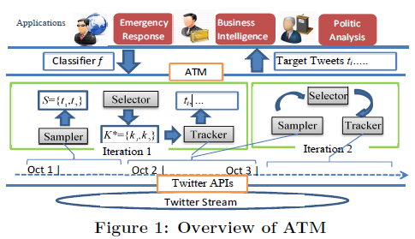
Automatic Topic-focused Monitor (ATM)
  Tweet Sampling
  Keyword Selection
ATM
  Data Acquisition
Data Preparation

Slide 8
f
i^{th}: Sampler Selector Tracker
    S_{i} {t₁:police detained… K_{i}: {police, theft} filter API with K_{i}
    t₂:car theft… maximum coverage “Police arrested…”
    t₃:enjoy my tea… {t₁, t₂}
    … }
i+1th: Sampler
S_{i+1}
Notes:
Optimal and Continuous??

Slide 9



Two Problems
uniform distribution: 均匀分布
Tweet Sampling
T: all the tweets in an iteration. n: a threshold, smaller than |T|.
filter and sample API Output:
S T, s.t. t_{i}, t_{j} T, P(t_{i} S) = P(t_{j} S) and |S| > n.(uniform distribution)
f: a classifier, T: tweets, K: candidate keywords, Output: L K, s.t. the number of the target tweets covered by L is maximized subject to cost constraints .
Sample random tweets (more than sample API: 1%)
Keyword Selection
Find the optimal keywords (under cost constraints)
Notes:
S should be uniformly sampled from T

Slide 10
Tweet Sampling Algorithm
Uniformly sample nodes from a graph via integrating two sampling methods
  Random walk sampling
  Rejection sampling
  Challenge: connect tweets as a “tweet graph G(T,E)” through the APIs

Slide 11
Random walk sampling
ergodic: 各态历经的
A person randomly walking among G(T,E)
  1. Burning period: it randomly walks for several steps
  2. It generates the next visited node as a sample
If G is ergodic (strong connected), the samples are generated according to the trial distribution defined by G

Slide 12
Rejection sampling
A simulation method for generating samples according to a target distribution with samples generated from a trial distribution.
Acceptance probabilities (according to two distributions)
Tweet Graph (T,E)-ergodic
Random walk sampling-trial distribution by G
Rejection sampling-target distribution (uniform distribution)

Slide 13
Keyword Selection Algorithm
Selecting a set of keywords that have the maximum coverage of target tweets
1. filtering cost: the number of selected keywords, threshold M
2. post-processing cost: total number of collected tweets, budget B
New greedy algorithm

Slide 14
Experiments and Results
Fixed Corpus: pre-crawled 5 million tweets
Twitter Stream: sample-select-track; iteration length l = 2 hours
Baseline Methods: BaseS (sample API), BaseM (filter API, manually), BaseH (filter API, heuristically)
Measure: c-rate (% target tweets covered) (recall), c-size (# target tweets covered), p-cost (# tweets collected)

Slide 15
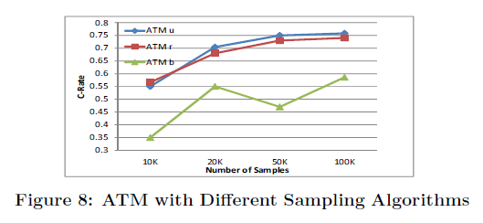
Sampling Algorithm
ATMu: uniform sampling
ATMb: biased sampling
ATMr: random walk based sampling

Slide 16
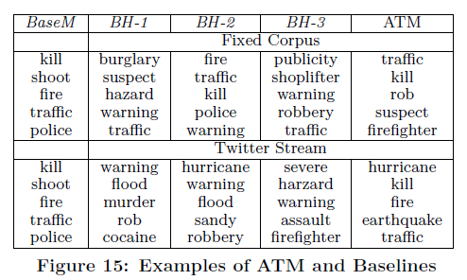
Keyword Selection
f: crime/disaster

Slide 17


ATM vs Baselines
M = 20, B = large value
c-rate (% target tweets covered)

Slide 18
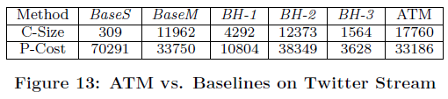
Twitter Stream Setting
l = 2h, M = 20, B = 140K, f: crime/disaster
Average c-sizes and p-costs per hour
c-size (# target tweets covered)
p-cost (# tweets collected)

Slide 19
Discussion
With my work on social media websites
Search the related drug information

